Slide 1
Stormwater Harvesting
A Solution for our Perils?
Texas Innovative Water Seminar
October 12, 2010
Ellen T. McDonald, Ph.D., P.E.
Alan Plummer Associates, Inc.

Slide 2
Acknowledgments
TWDB Research Project # 0804830853- Stormwater Harvesting as a Water Management Strategy
  Jorge Arroyo, Dr. Saqib Shirazi (TWDB)
  Margie Nellor (Nellor Environmental Associates, Inc.)
  Andrew Chastain-Howley (Miya Water)
  Brian McDonald, Alan Plummer (APAI)

Slide 3

Peril #1
“Oh no! Traditional water supplies are becoming increasingly difficult (and expensive) to acquire!!!”
Graphics from “Underdog” TV Series

Slide 4

Peril #2
“Increased urbanization leads to increased runoff, flash flooding, degraded water quality, and more erosion. We need help!”
Graphics from “Underdog” TV Series

Slide 5

“Sweet Polly, I am on my way!”
Graphics from “Underdog” TV Series

Slide 6

Can Polly be Saved?
Graphics from “Underdog” TV Series

Slide 7
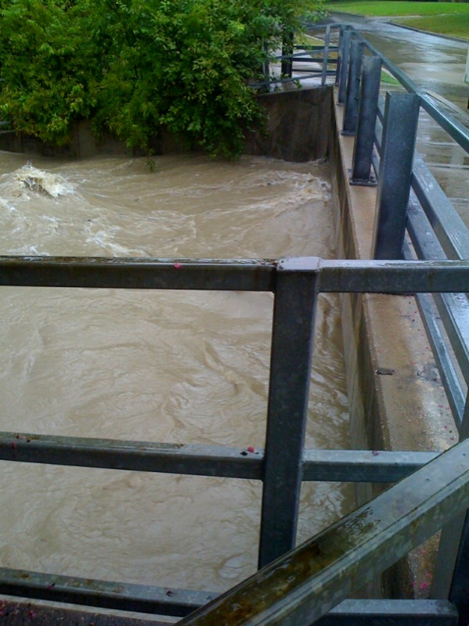
What is Stormwater Harvesting?
Collection, storage, treatment, distribution, and use of stormwater runoff for beneficial purposes
Notes:
Pic from Lauren’s phone ☺

Slide 8
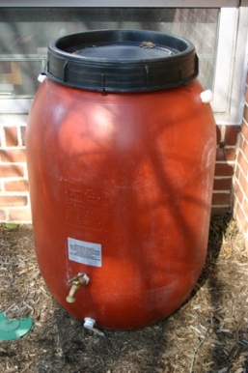
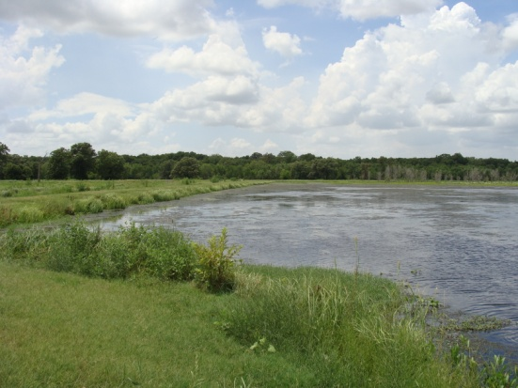
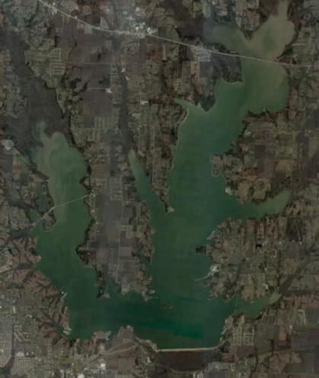
Scales of Stormwater Harvesting
Rain barrel reference: http://www.dnrec.delaware.gov/News/Pages/DNRECoffersrainbarrelsatdiscountpriceinMay.aspx
Wetland reference: TRWD wetland
Lake reference: Lake Lavon, google earth
Rain Barrels
Increasing Size
Ponds and wetlands
Large reservoirs
Notes:
Rain Barrel: http://www.dnrec.delaware.gov/News/Pages/DNRECoffersrainbarrelsatdiscountpriceinMay.aspx
Wetland: in house, NTMWD
Large Reservoir: google earth

Slide 9

Potential Benefits
Reduced potable water demands
Reduced stormwater flows/flooding
Reduced erosion/scouring
Reduced stormwater pollutant loads
Better match of quality and use
Can create public amenities
Low energy requirements

Slide 10

What is potential for stormwater harvesting in Texas?
Reference: http://www.thegreenguide.com/buying-guides/rain-barrels/img/rain-barrel-330.jpg
Notes:
Picture from: http://www.thegreenguide.com/buying-guides/rain-barrels/img/rain-barrel-330.jpg

Slide 11
Factors influencing stormwater harvesting potential
Supply
  Rainfall volume, frequency, timing
  Runoff potential
  Evaporative losses
Demand
  Projected water needs and timing
  Climatic region

Slide 12
Factors influencing stormwater harvesting potential
Implementation issues
  Cost of other water supply alternatives
  ASR potential
Other
  Stormwater quality
  Environmental impacts
  Public acceptance
  Water rights issues

Slide 13
Relative potential by planning region
Notes:
Back of envelope calculation-
667 sq. miles- developed, high intensity
1,538 sq. miles developed, medium intensity
Avg. runoff coeff = .5
Harvest 10% of runoff from developed areas– 218,000 ac-ft/yr

Slide 14
Project Implementation

Slide 15
The first step- develop a plan!
Define
  Project objectives
  Site and watershed characteristics
  Potential users/demands
  Regulatory constraints

Slide 16
The first step- develop a plan!
Quantify stormwater availability
Evaluate environmental issues
Determine water quality/treatment requirements
Identify public awareness needs
Plan for risk management
Evaluate costs/benefits

Slide 17
How much storage??
Diminishing returns: large increases in storage capacity only give small increases in yield reliability.
Small increases in storage capacity give large increases in yield reliability.
Adapted Mitchell, V.G., Hatt, B.E., Deletic, A., Fletcher, T., McCarthy, D., and Magyar, M., 2006b, Integrated Stormwater Treatment and Harvesting Technical Guidance Report: prepared for the Institute for Sustainable Water Resources, Monash University, ISWR Report 06/05, URL http://iswr.eng.monash.edu.au/research/projects/stormwater/final_report.pdf.

Slide 18
How much and what kind of treatment?
Depends on end use and project goals

Slide 19
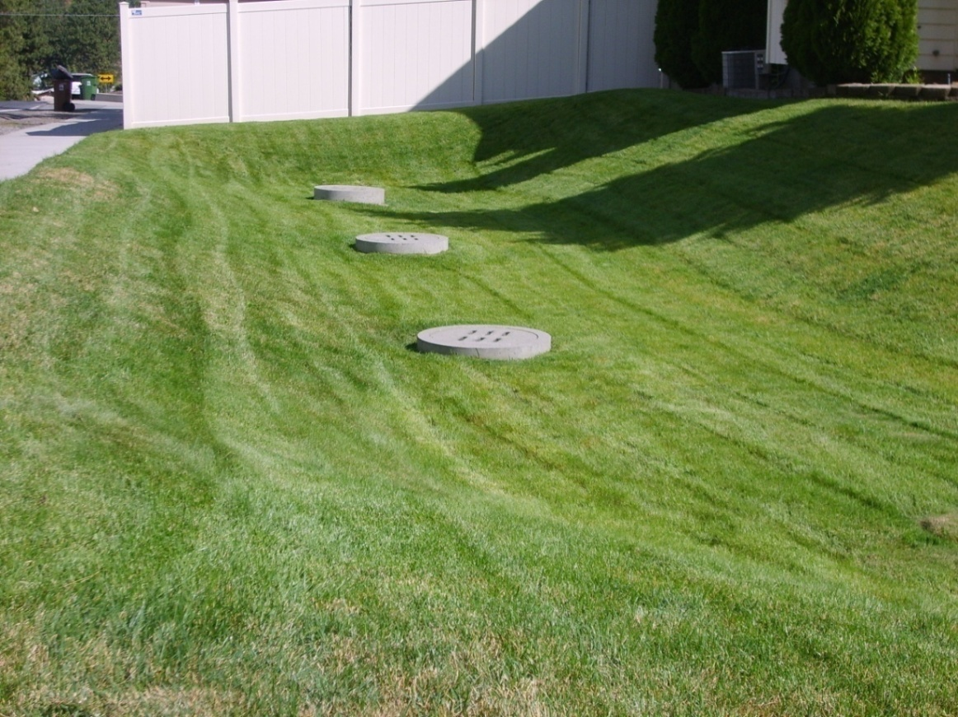
Treatment options
Vegetative
(grassed swales, filter strips)
Reference: http://www.spokanewastewater.org/images/Swale3.jpg
Notes:
http://www.spokanewastewater.org/images/Swale3.jpg

Slide 20
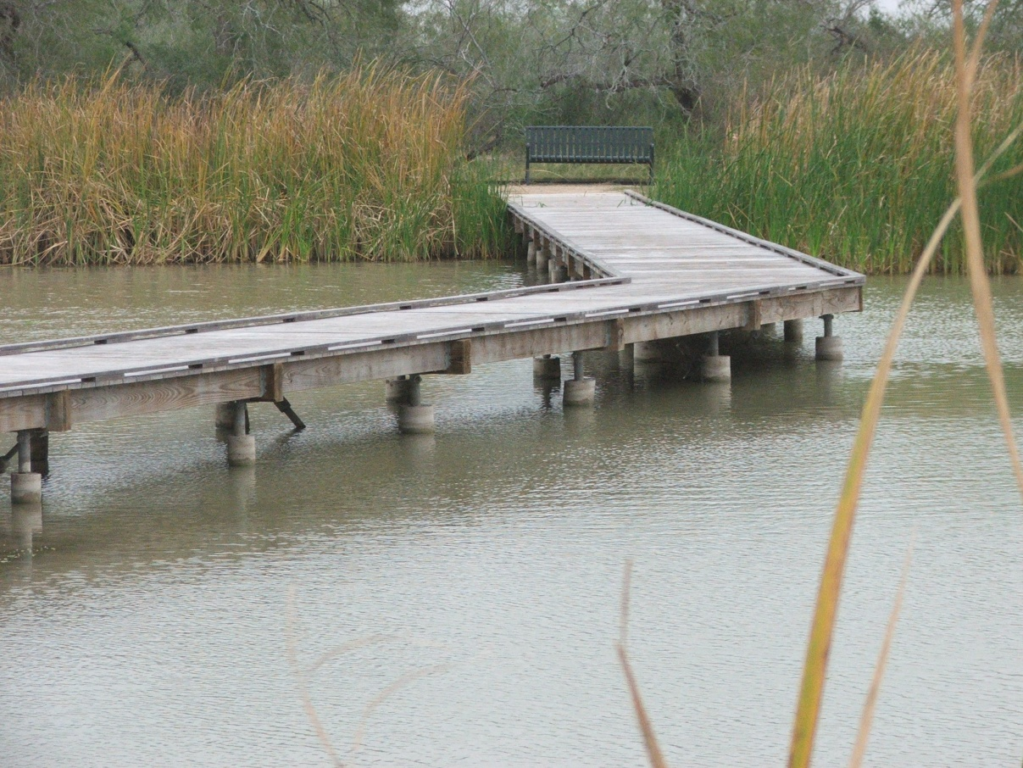
Treatment options
2) Detention facilities
(ponds, wetlands)

Slide 21
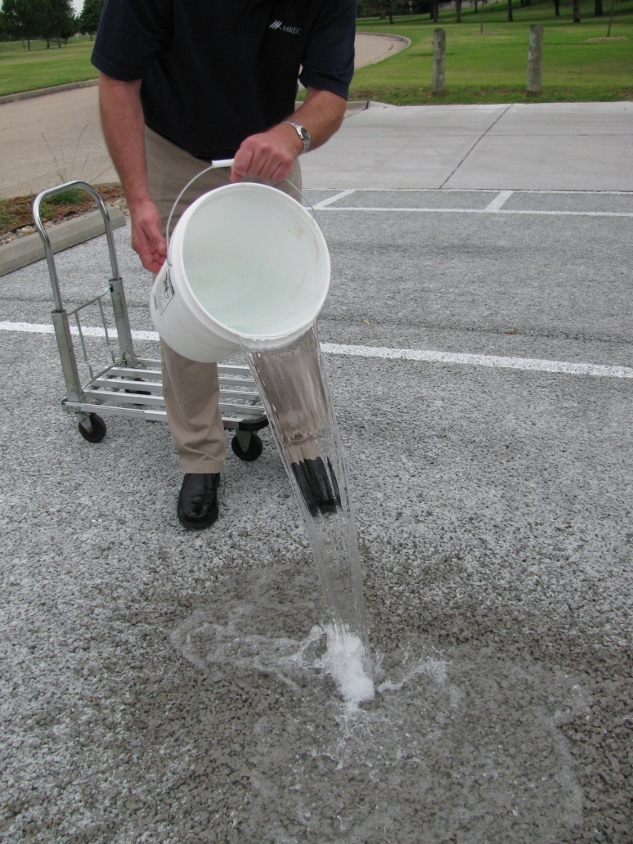
Treatment options
3) Infiltration facilities
(basins,
trenches,
porous
pavements)
Reference: http://www.wichita.gov/CityOffices/PublicWorks/StormWater/Water+Center+Pervious+Pavement+and+Rain+Garden.htm
Notes:
http://www.wichita.gov/CityOffices/PublicWorks/StormWater/Water+Center+Pervious+Pavement+and+Rain+Garden.htm

Slide 22
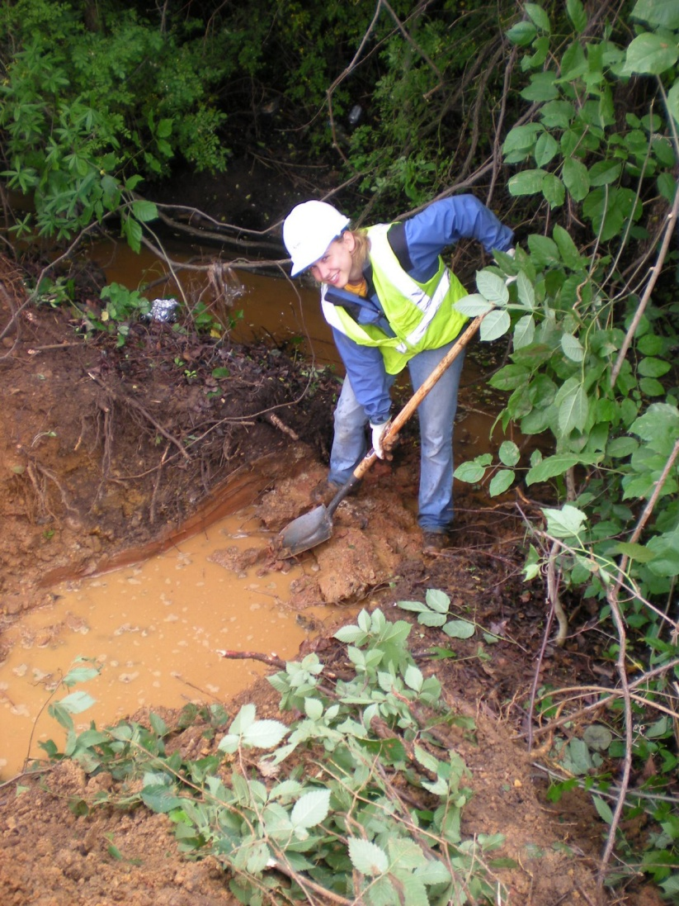
Treatment options
4) Filtration practices
(sand filters,
bioretention
systems)
Reference: http://www.eng.umd.edu/media/pressreleases/images/anacostia1.jpg
Notes:
http://www.eng.umd.edu/media/pressreleases/images/anacostia1.jpg

Slide 23
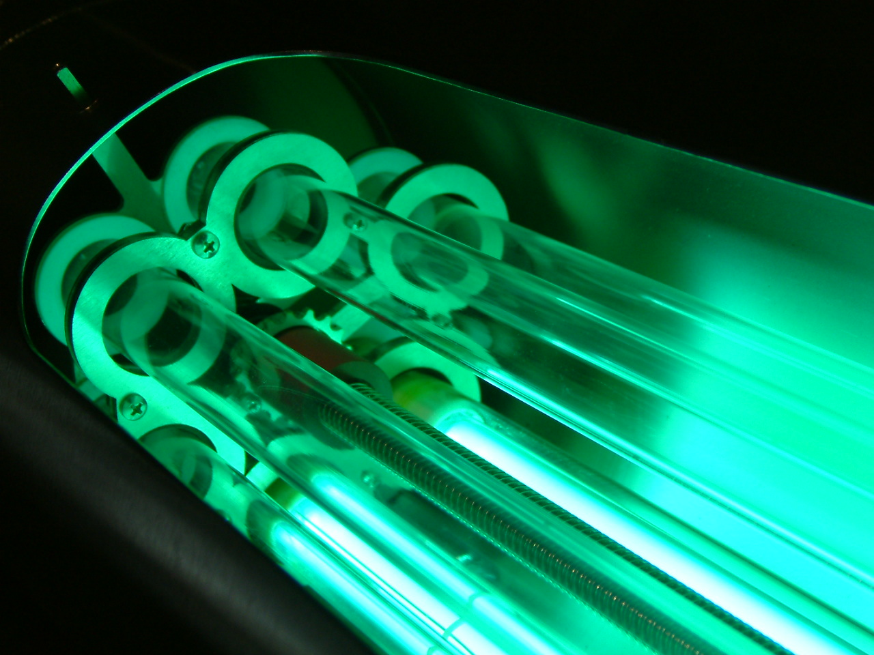
Treatment options
5) Disinfection
Reference: http://www.siwi.org/sa/node.asp?node=537
Notes:
http://www.siwi.org/sa/node.asp?node=537

Slide 24
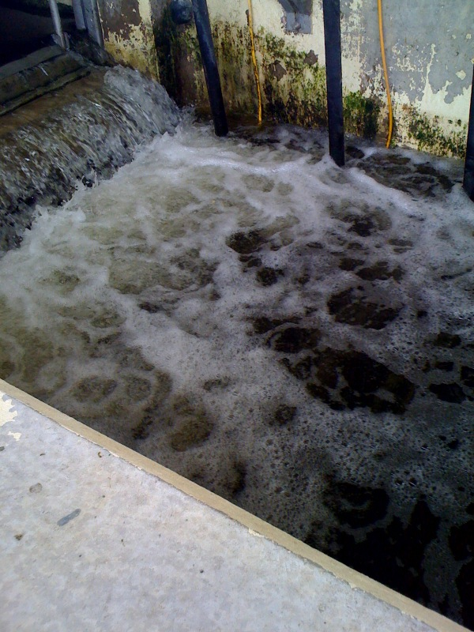
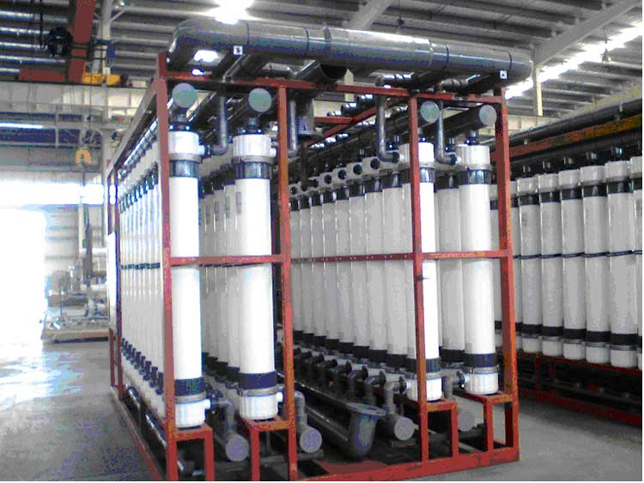
Treatment options
6) Advanced treatment
Notes:
Filter, discharge at denton creek

Slide 25
Case Studies

Slide 26
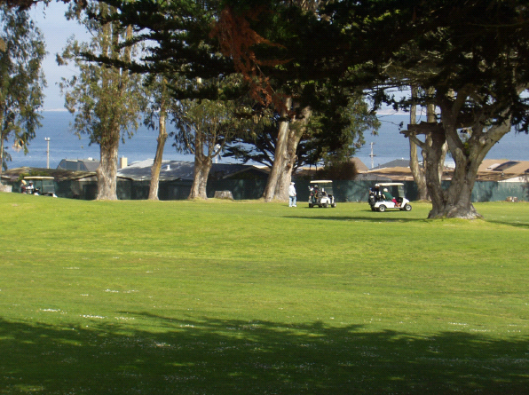
Pacific Grove, California
Project goals
  Reduce pollution to Monterey Bay
  Develop new local water supply
  Regulatory compliance
  Enhance Monarch Butterfly habitat

Slide 27
Pacific Grove, California
Project components
  Trash/debris separator
  Storage reservoir
  Constructed wetland
  Advanced treatment (microfiltration, ultraviolet light)
Provides irrigation water for golf course, park, athletic fields, cemetery
Financed through city-wide stormwater recycling charge
Notes:
Capital cost of $15.2 million
O&M $200,000/yr
$6 million funding from “outside sources”
$900,000/yr of annual cost financed through recycling charge ($9/dwelling unit per month!!)

Slide 28
City of Tucson
All new “commercial” development in the City of Tucson must meet 50% of its irrigation requirements through stormwater harvesting.
Applies to commercial, office, retail, industrial, mixed-use, and private and charter schools
Effective
June 1, 2010

Slide 29
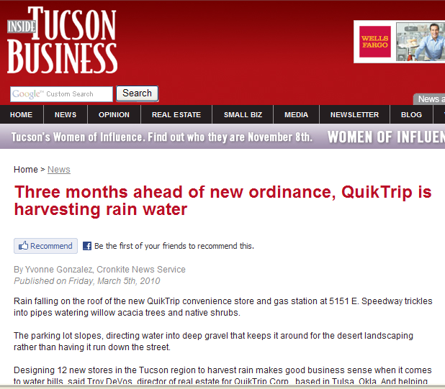

Slide 30
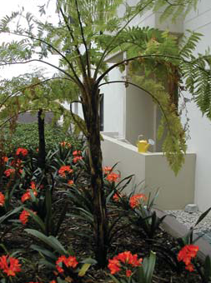
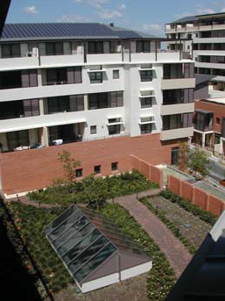
Kogarah Town Square
New South Wales, Australia
2.1 acre mixed-use development
  193 apartments
  1.1 acres of retail, commercial and library space
Reference: http://www.kogarah.nsw.gov.au/resources/documents/Town_Square_Fact_Sheets_WATER.pdf
Notes:
Graphics from: http://www.kogarah.nsw.gov.au/resources/documents/Town_Square_Fact_Sheets_WATER.pdf

Slide 31
Kogarah Town Square Project Objectives
Avoidance of flooding
Reduce impact on receiving water
Reduction of potable water demand
Aesthetics
Enhanced appreciation of water in the urban environment

Slide 32
Notes:
Stormwater runoff from paved areas is screened with a gross pollutant trap and collected in a series of underground “dirty water” storage tanks (Figure 8-9). The collected stormwater is used to irrigate landscaped areas. The landscaped areas contain soils that have been biologically engineered to filter first flush general runoff.⁽²³⁾ Water that filters through the soil is collected into a series of underground “clean water” storage tanks.
Rainwater runoff is collected from roofs and upper terraces, passed through a screen and silt trap, and collected in the “clean water” storage tanks. The clean water is used for toilet flushing and car washing. Some of the “clean water” is filtered, disinfected, and used to maintain a water feature.⁽¹⁴¹⁾
Other facts about stormwater harvesting at Kogarah Town Square include:
During times of low rainfall, potable water is added to the water feature and to the “dirty water” tank (for irrigation).⁽¹⁴¹⁾
The average annual rainfall at Kogarah Town Square is 43.4 in/yr, generating a runoff volume of approximately 2.17 MG, of which about 85 percent is collected for onsite use.⁽¹⁴¹⁾ The storage capacity is 380,000 gallons, enough to capture the 3-month-frequency storm.
At least 70 percent of the toilet flushing water demand is supplied with stormwater, and estimates of overall potable water savings from stormwater harvesting range from 17 percent to 25 percent.^{(23,141)}
The capital cost of the stormwater elements of the project was $522,000. Reduced potable water consumption saves approximately $2,000 per year, and removal of total nitrogen is worth $4,000 to $31,000 per year.⁽²³⁾
It is expected that screen filters on the pumps will need to be cleaned once a year and that the storage and header tanks will need to be cleaned every 5 to 6 years. No water quality monitoring is performed.⁽²³⁾
For costs in this paragraph, conversion to 2009 U. S. dollars based on 2003 average exchange rate of 0.652 U. S. dollars per Australian dollar and Engineering News-Record (ENR) Construction Cost Indices of 8564 (August 2009) and 6733 (August 2003).

Slide 33
Summary
Stormwater harvesting provides local source of water that reduces potable water demands
Stormwater harvesting provides multiple benefits
Stay tuned for discussion of legal/regulatory issues…

Slide 34
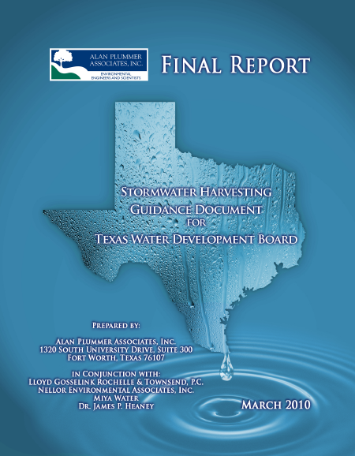
QUESTIONS?
Ellen McDonald, Ph.D., P.E.
Alan Plummer Associates, Inc
Fort Worth, TX
emcdonald@apaienv.com
817-806-1700

